Slide 1
Marine Trades
Training, Innovation & Good News
Northwest Marina & Boatyard Conference
La Conner, Washington
November 9, 2011
Center of Excellence, Marine Manufacturing & Technology
Skagit Valley College

Slide 2
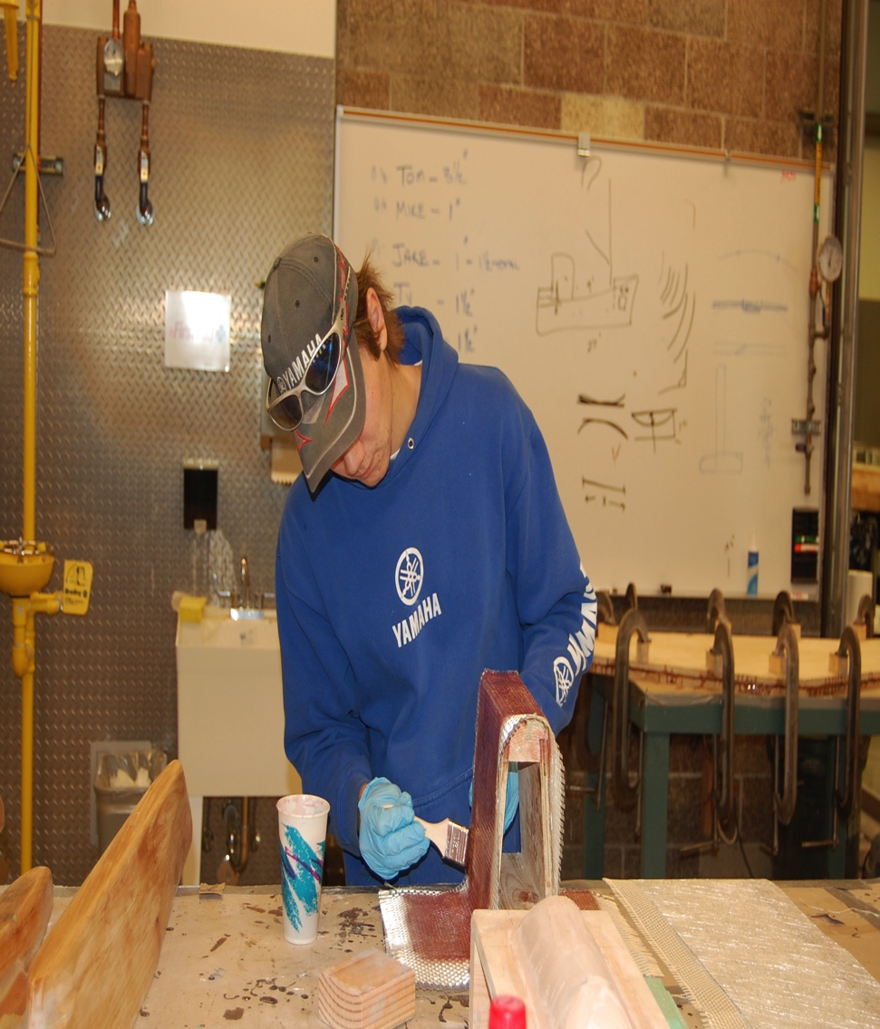
Marine Technology Campus - Anacortes
19,000 square feet
Opened September 2010
Dual programs with wait lists
  Skagit Valley College - Marine Technology
  Northwest Career & Technical Academy/K12
Key support & leadership
  Port of Anacortes
  Marine trades
  Legislative
  Community

Slide 3
Training for the following markets
Boat & ship building
Repair-refit yards
Marina’s
Enthusiasts

Slide 4
State-of-the-Art Training
Systems
Propulsion
Composites
Welding

Slide 5
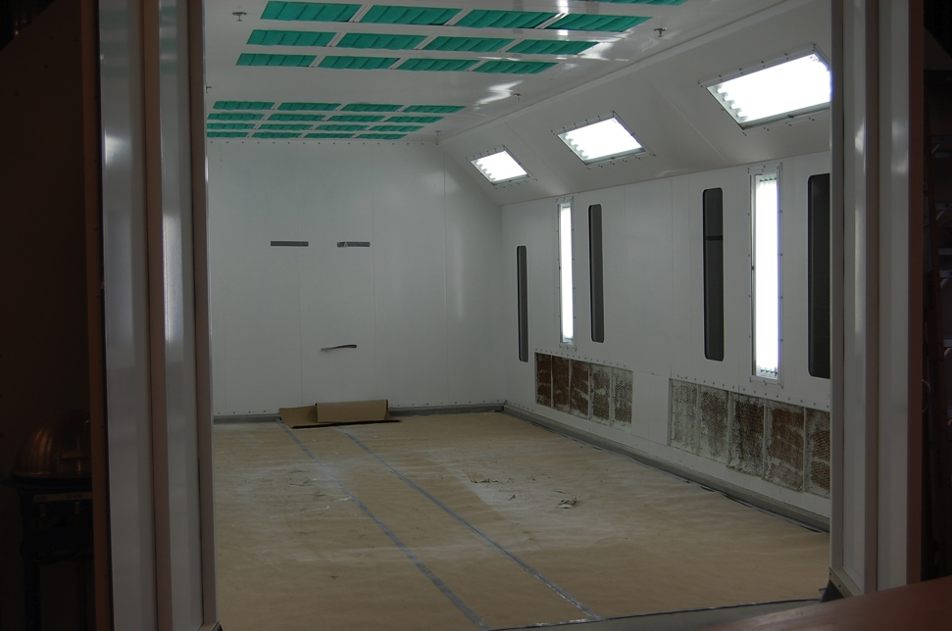
Training Standards
Meet local, regional and national industry standards
  Advisory board
  Expanded composite tooling to attract younger students
Training aids that represent current and emerging technologies and best practices
  Industry – key player
Regular review of curriculum and outcomes

Slide 6
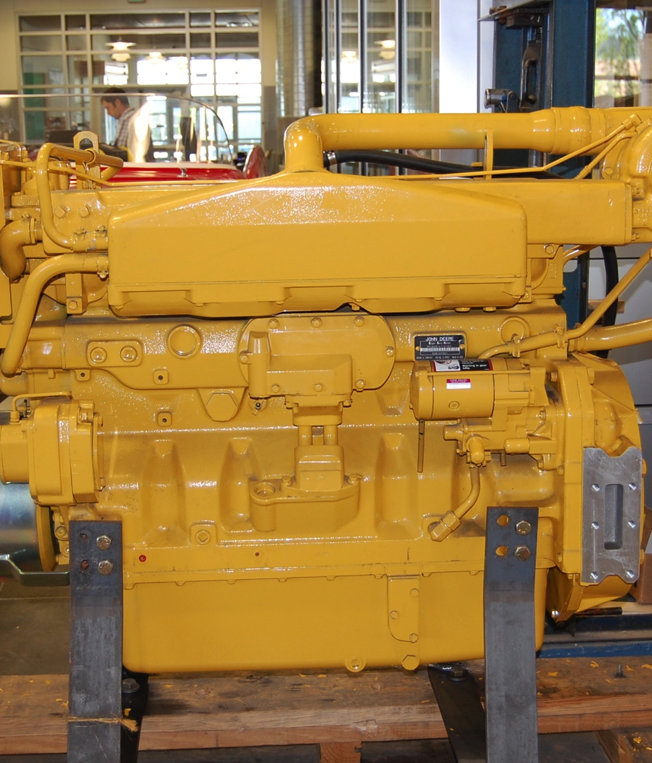
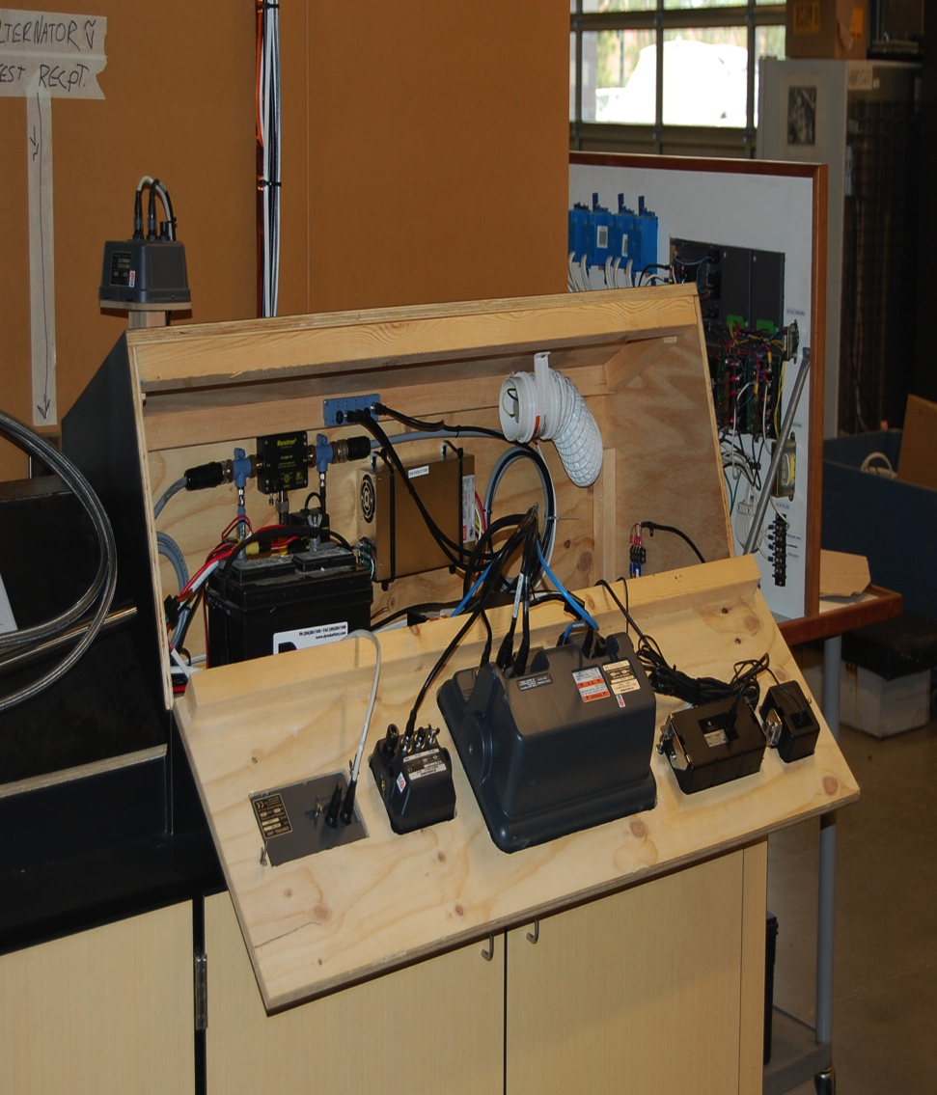
Training aids

Slide 7
Certifications and degrees
One year Marine Technician Certificate
Two year Associate of Technical Arts degree
American Boat and Yacht Council
  Marine Electrician
  Systems Technician
  Corrosion Technician
  Propulsion Technician – Gasoline and Diesel
National Marine Electronics Association
  Marine Electronics Installer
  Advanced Marine Electronics Installer
American Composite Manufacturers Association
  Various composite certifications
EPA – Part 608
American Welding Society

Slide 8
Upcoming events and courses
Professional development for industry – Spring 2012
  Electronics
  Composites
Marine WX
  Recreational boaters – January 14, 2012
  Industry
Recreational community classes – Spring 2012
  Systems for Women
  Diesel engine trouble shooting
  Rigging
Online/eLearning for students and incumbent employees
  Marine Technical Math
  Composite Technology
  Marine Electronics

Slide 9
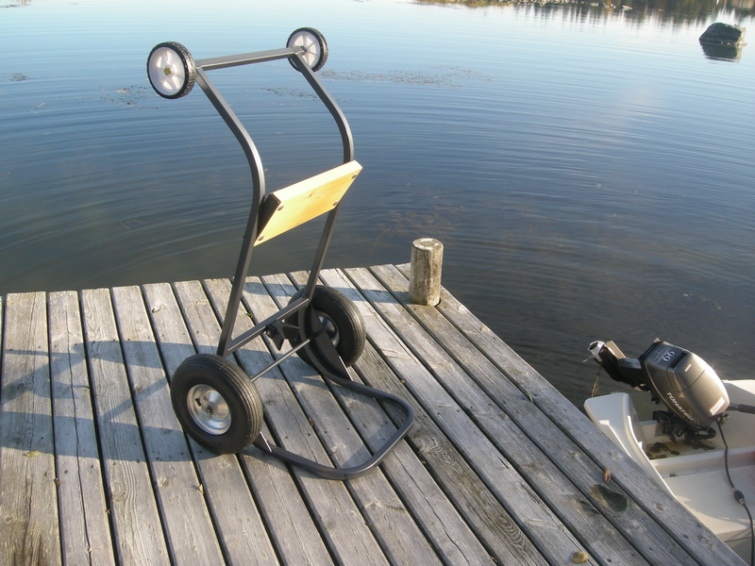
Good news…there really is some!
Technological Innovation
  Easy-Motor-Toter: www.brunco.se
  Universal Sprayless Connector: www.attwoodmarine.com
  IMC Marine Charger: www.charlesindustries.com
  Thetford Porta-Potti Curve: www.thetford.com

Slide 10

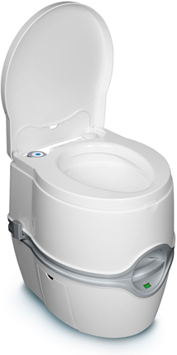

Slide 11
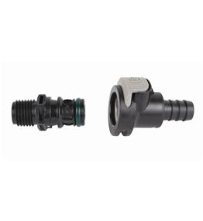
Good news, continued
Increased legislative interest in industry
  Active outreach by elected officials
Scholarship fund: $93,000!
  Original goal: $20,000
  New goal: $100,000
  Wallie Funk, Community Leader
ProBoat West
  30 minute live radio show
  Focus is on West Coast industry
  Partnership with Professional BoatBuilder magazine

Slide 12


Thank you!
Visits to Marine Tech are encouraged!
For more information
  Ann Avary
  ann.avary@skagit.edu
  360.766.6282, x3001
  www.marinecenterofexcellence.com
  www.skagit.edu

